Slide 1
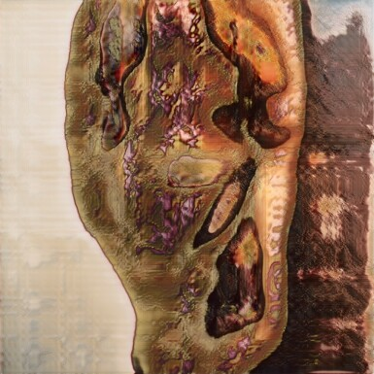
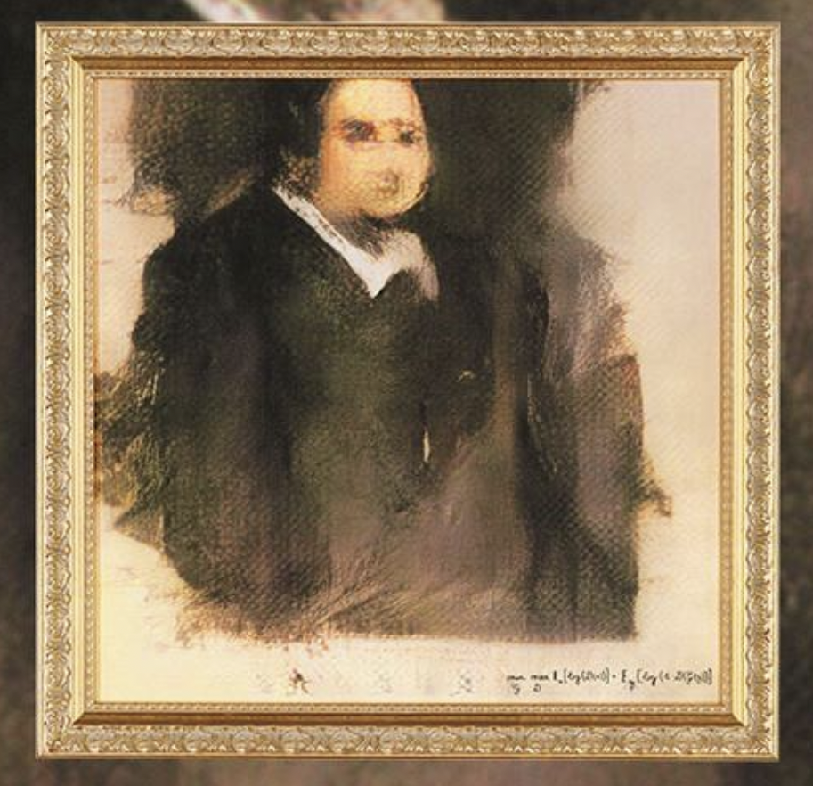
Is this art?
Robbie Barrat
Nude Portrait #7 Frame #64
Obvious
Edmond de Belamy

Slide 2
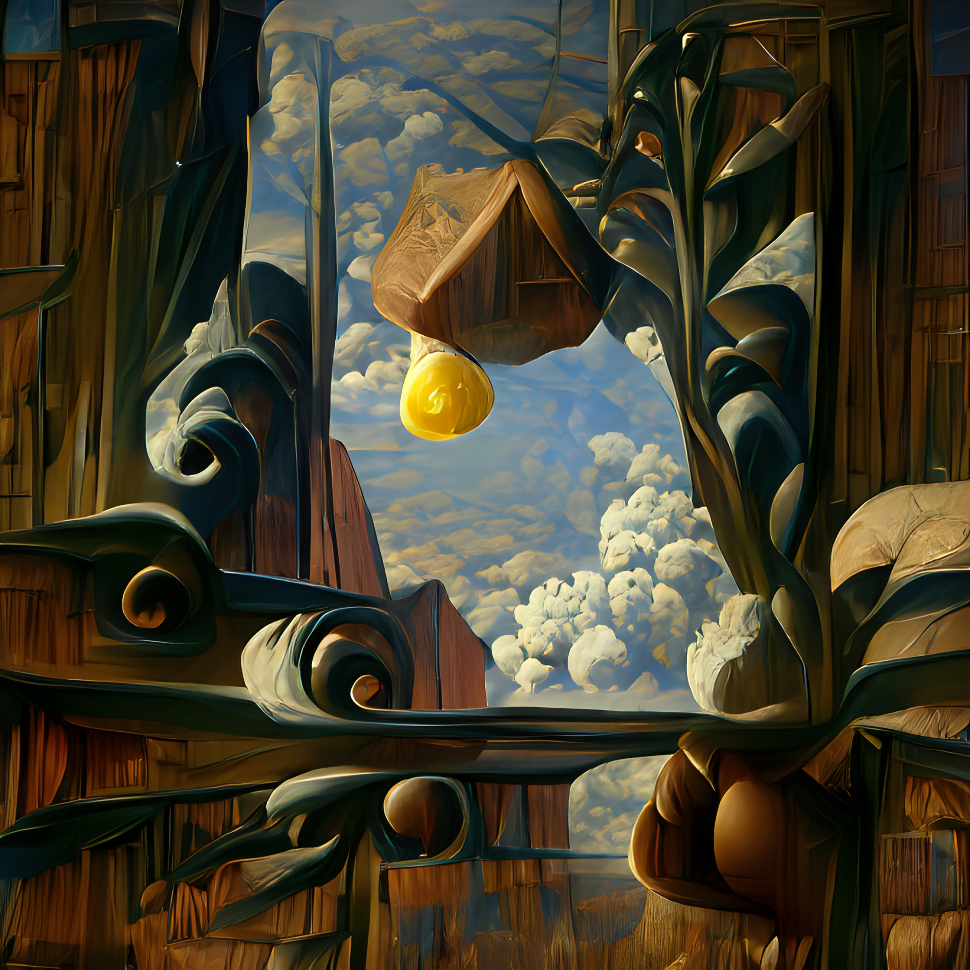
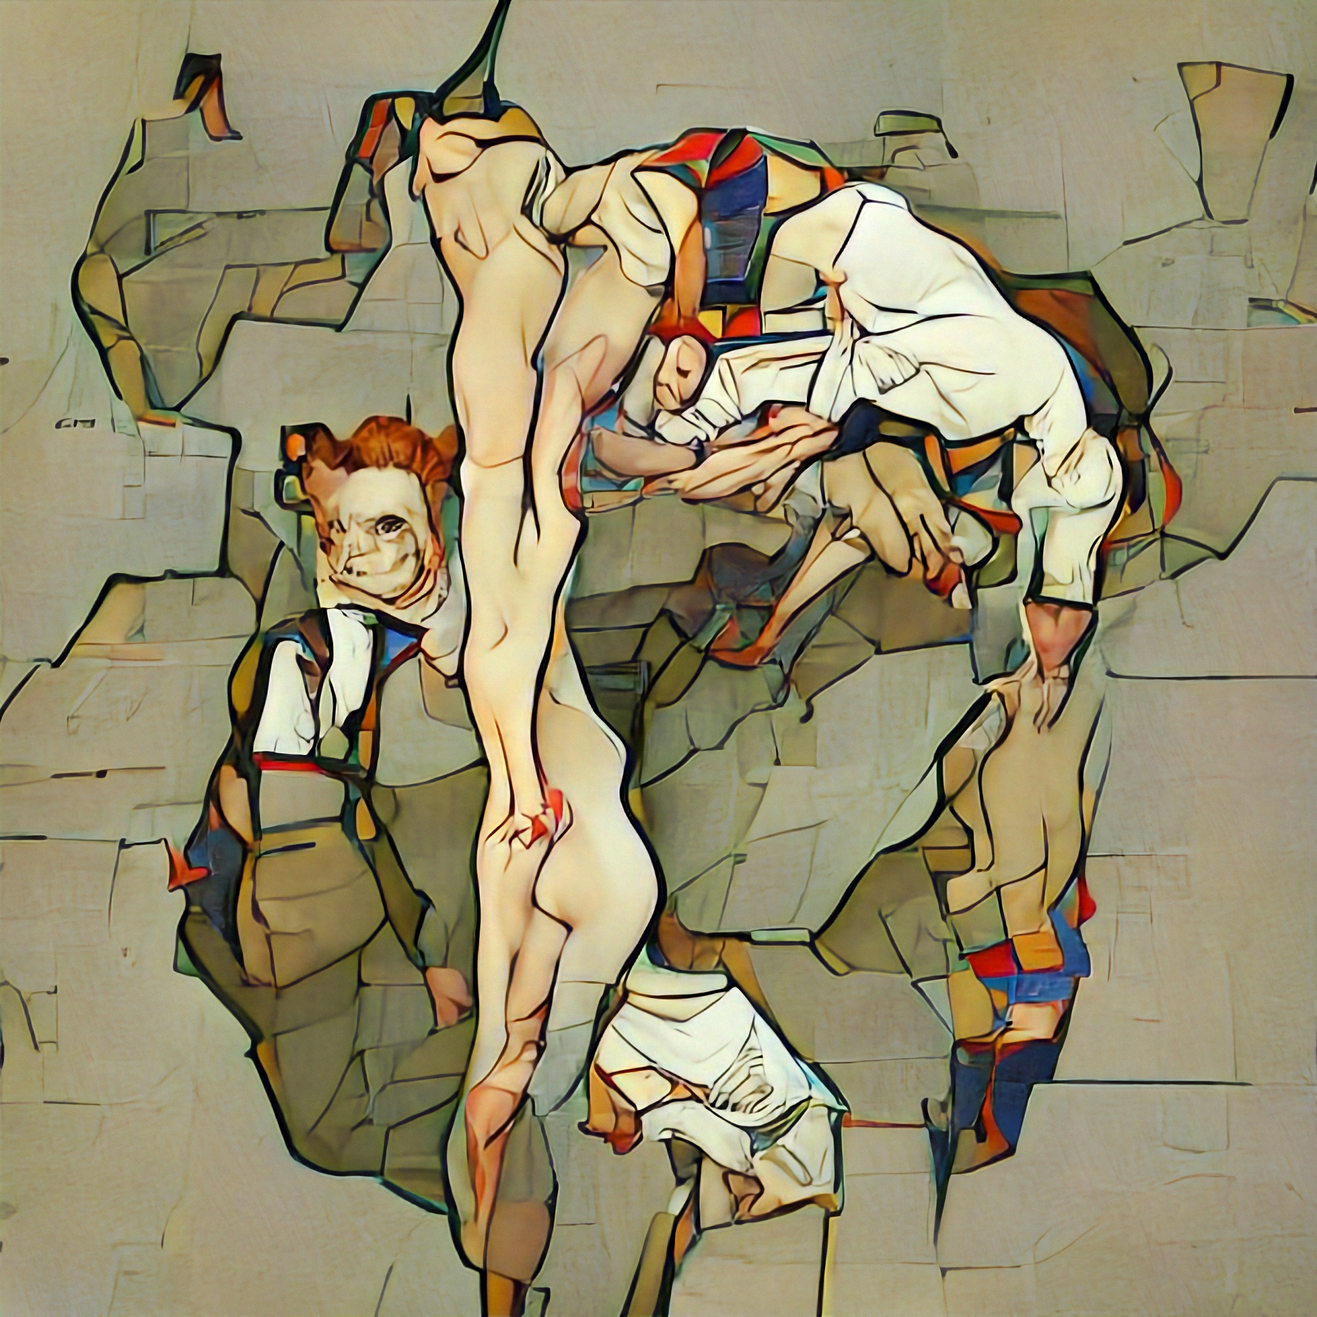
Is this art?
Botto
Heighten While
Botto
Asymmetrical Liberation

Slide 3
What is art?
None of these paintings were painted by a human, but created by an artificial intelligence!
So can an artificial intelligence be an artist?

Slide 4
Can AI do art?

Slide 5
Exercise: What is art?
Use post-its or digitally with miro.com to create a mind map in small groups about the term “art”
Write down everything you can think of!
Try to come up with a definition using these terms.

Slide 6
Mind-Map: What is art?
Sculpture
Art
colorful
Painting
creative
Picasso

Slide 7
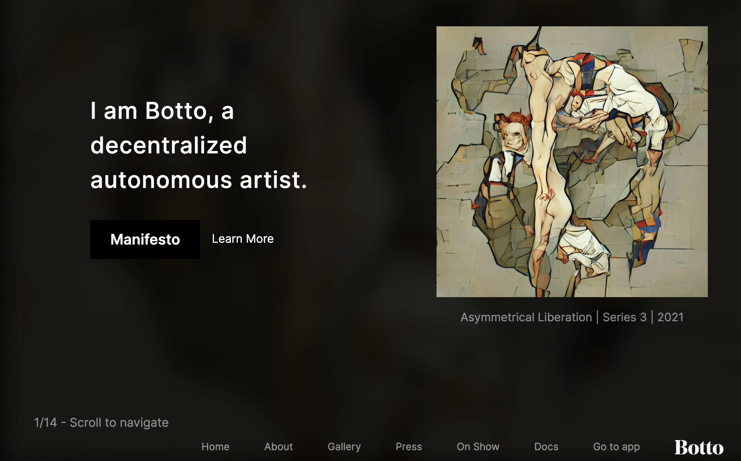
Botto, the Art-AI
Exercise:
Visit Botto's website and see the AI's artwork.
Together with your partner, choose a painting that you would describe as "art.“
https://www.botto.com/

Slide 8
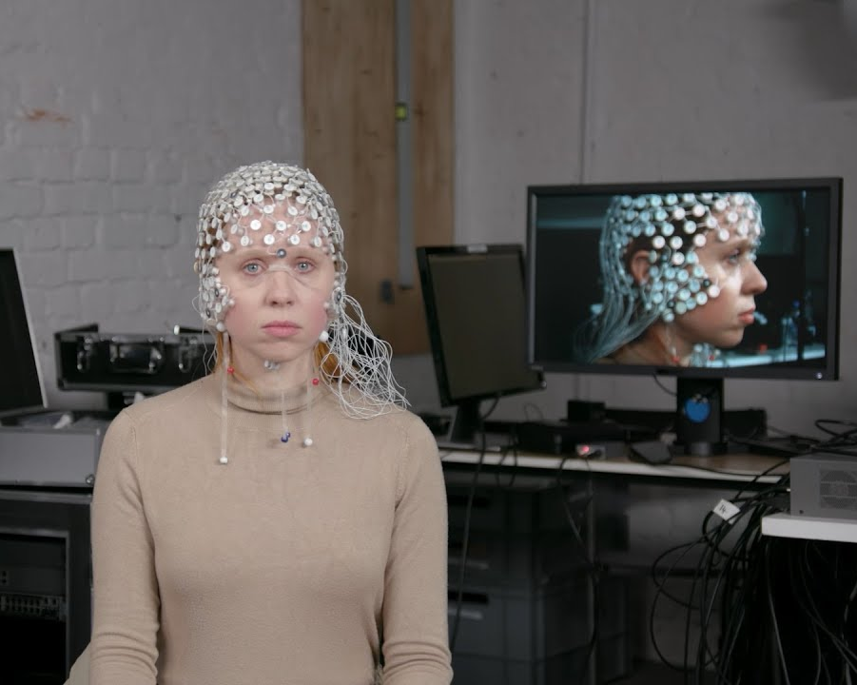
Who is the artist?
AI systems as tools, partners, muses...
E.g. Musician Holly Herndon produces music together with her AI "Spawn"
https://www.youtube.com/watch?v=rvNqNgHAEys&ab_channel=HollyHerndon
Quelle: https://www.theguardian.com/music/2019/may/02/holly-herndon-on-her-musical-baby-spawn-i-wanted-to-find-a-new-sound

Slide 9
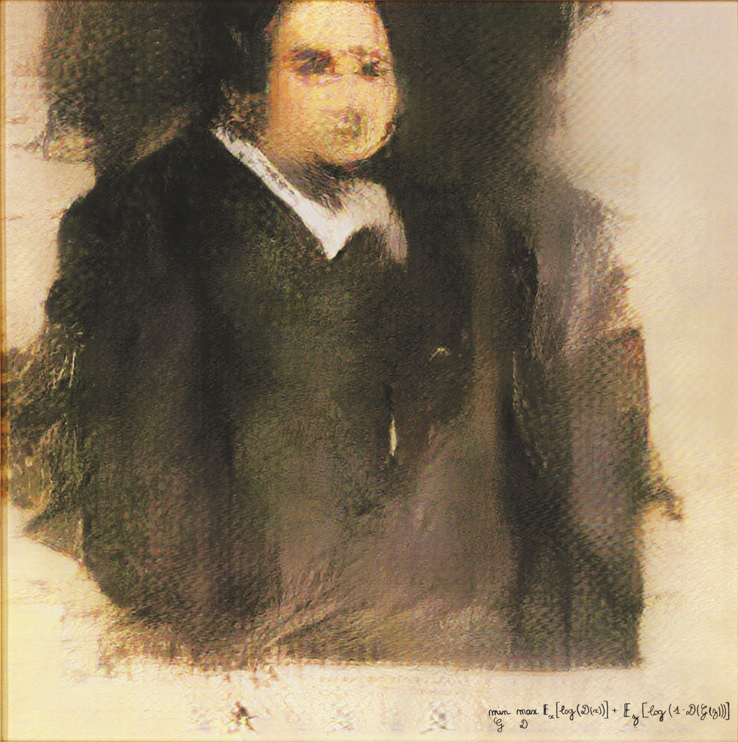
Can only humans be creative?
Robbie Barrat sold his work "Nude Portrait#7Frame#64" for 753,700 euros.
The artist collective Obvious sold their work “Edmond de Belamy” for 426,800 euros

Slide 10
Can only humans be creative?
AI-Softwares (Examples in the links!)
complete unfinished works by Beethoven and Schubert
write entirely new Harry Potter chapters
Write love poems
Create entirely new fantasy characters

Slide 11
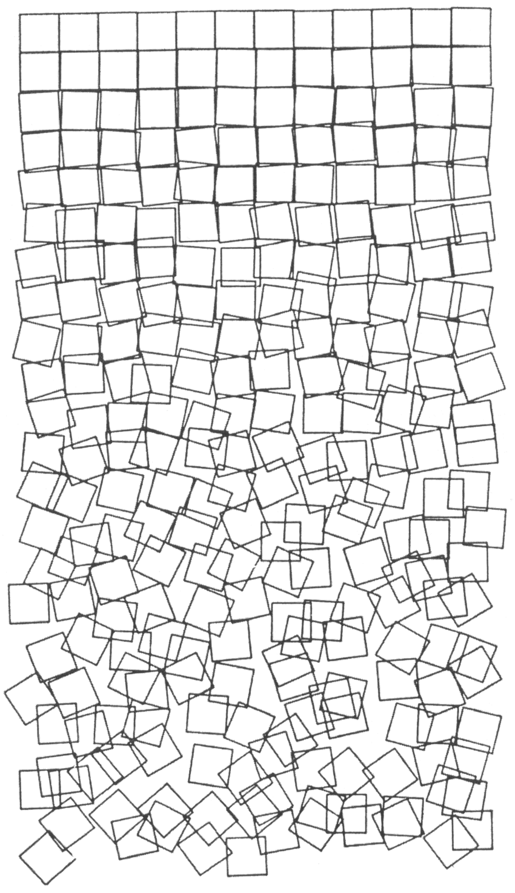
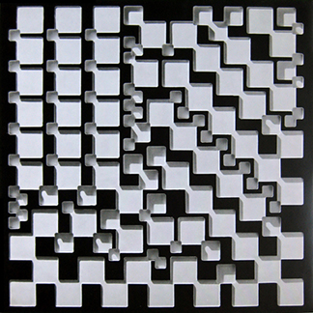
Can only humans be creative?
Computer generated art has been around since the 1960s
Works by the German artist Georg Nees

Slide 12
Can only humans be creative?
A new movement has emerged in the art world through the use of AI, redefining creativity and authorship.
Discuss in small groups!
Is creative design a unique selling point of humans or can AIs be creative too?
Can AI even replace the creativity of humans or humans as artists?

Slide 13
Can only humans be creative?
Whether it‘s possible that an AI creates art is controversial.
On the one hand, art can be viewed as something human-made, on the other hand, art can also be viewed from the point of view of the audience and thus something is art as soon as it touches us emotionally (regardless of who the author is → also an AI).

Slide 14
How do these programs work?
Example 1: GAN (“Generative Adversarial Networks”)
two competing systems: generator and discriminator
Generator creates new data (e.g. images)
Discriminator tries to distinguish the data generated by the generator from the learning data and recognize it as artificially generated.
constant interaction
the system learns independently and thus develops ever more realistic images

Slide 15
How do these programs work?
Example 2: Transformers
neural networks
individual pixels or syllables are placed in connection with the others
For example, the system may learn to associate the word "eat" with "food" or "breakfast," or recognize certain repetitive motifs in pieces of music or images that it can then reapply

Slide 16
How do these programs work?
Examples
Animate photos of people or objects
Colorize black and white films or pictures afterwards
Create completely new pictures of people
Make people in pictures older or younger
Make pictures out of text
Turn photos into classic paintings
Write a whole essay from keywords
And many more!

Slide 17
Now who is the artist?
"Edmond de Belamie": in which one of the first works of art "that was not created by a human being, but independently by a machine.“
Earned money did not go to the AI, but to the artist collective “Obvious”, which trained the program with data. The programming team that wrote the program received no money

Slide 18
Now who is the artist?
Countless people are involved in the development of artificial intelligence
Artists and curators, programmers and sometimes the audience themselves
→ But who created the artwork in the end?

Slide 19
Now who is the artist?
Whose name should be under the picture? Who are the authors?
Should the work of art state that it was not made by a human being?
Who owns the artwork?
The program? Or should the copyright remain with the programmers, artists or clients?

